Slide 1



PEILab Group Meeting
Leader: Zicong Hong
Team Member: Jian Lin, Haodong Wang, Qianli Liu, Kaibin Guo, Junjie Liu

Slide 2
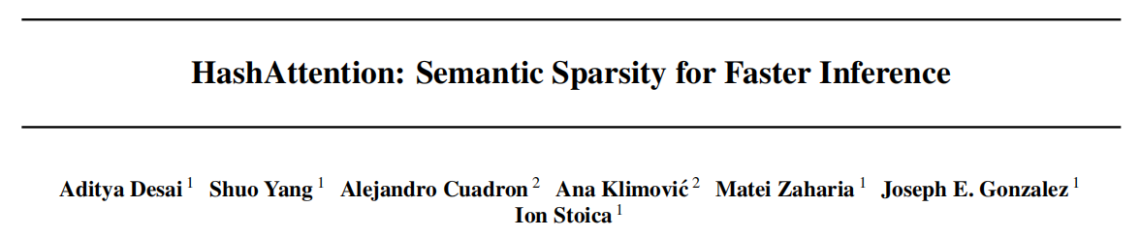
HashAttention
ICML’25

Slide 3
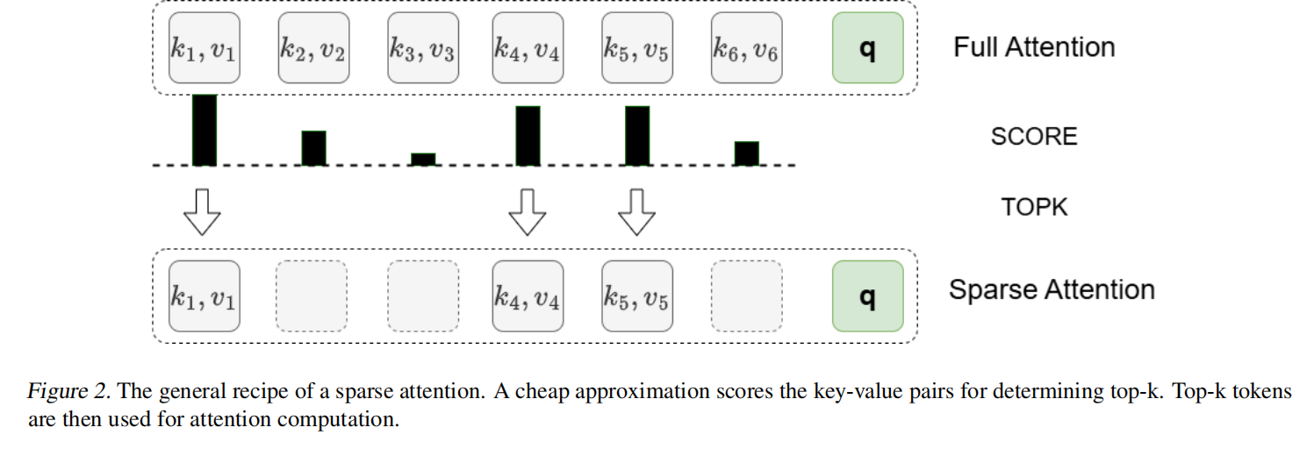
HashAttention

Slide 4
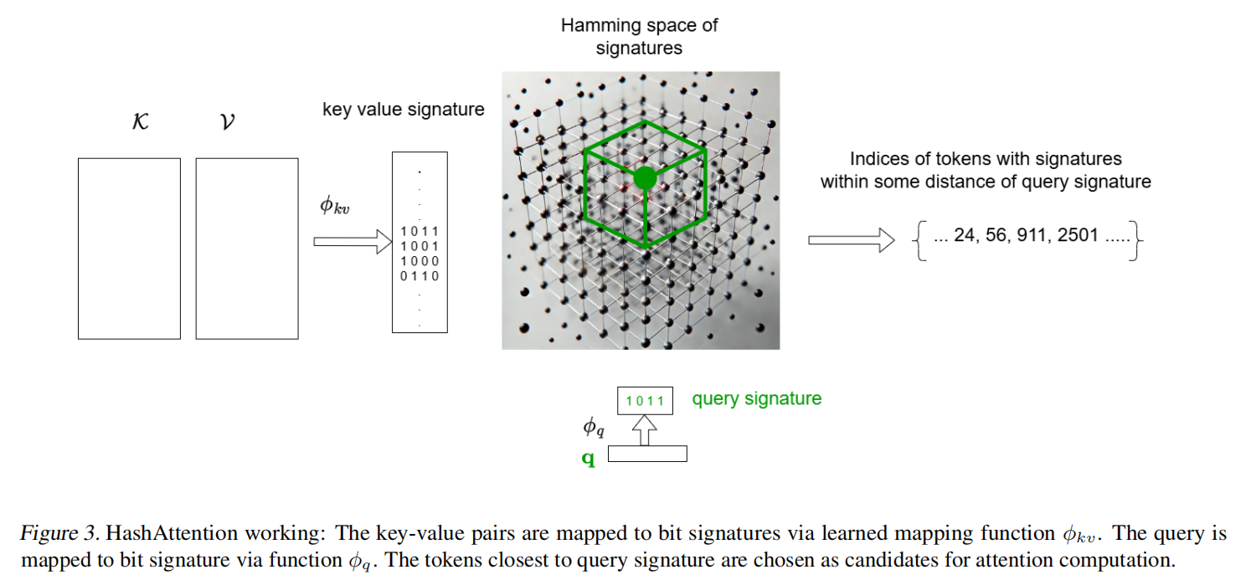
HashAttention

Slide 5
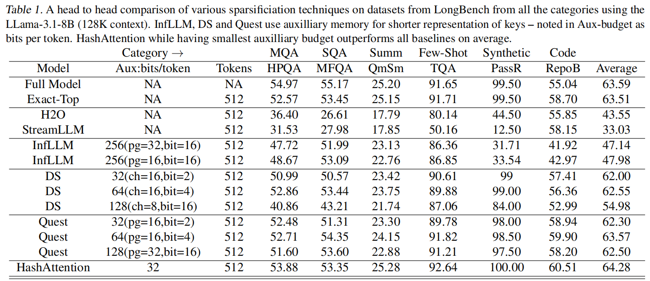
HashAttention

Slide 6
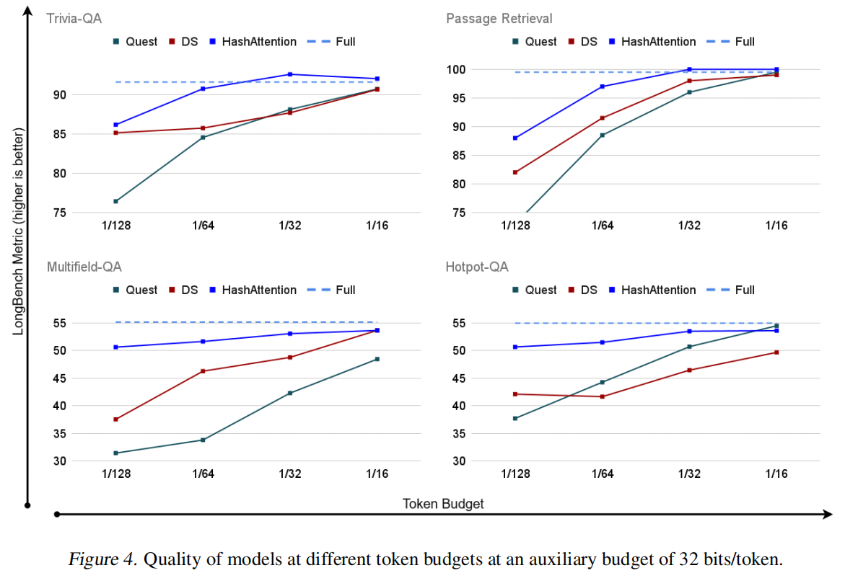
HashAttention

Slide 7
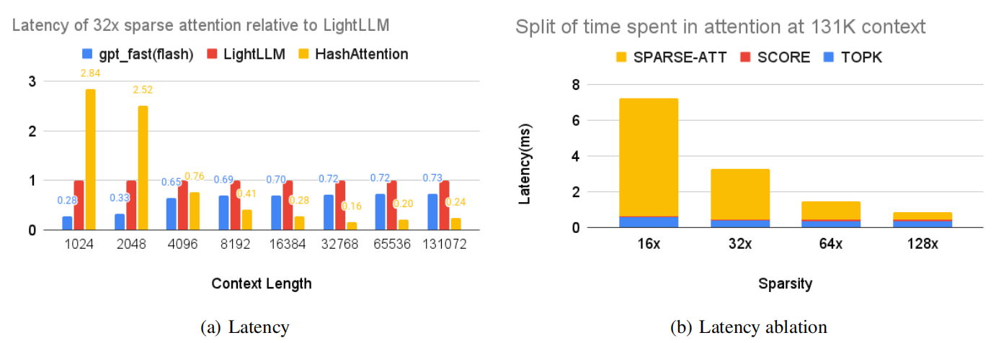
HashAttention

